Slide 1

CT4005: Games Production
Lecture 03 – Rules of Games
John Moss, Dr Will Sayers, University of Gloucestershire

Slide 2
LECTURE OUTLINE
Rules in games
3 part model
Identity and elegance
Human factors
Structure = Lecture > Practical > Assignment

Slide 3
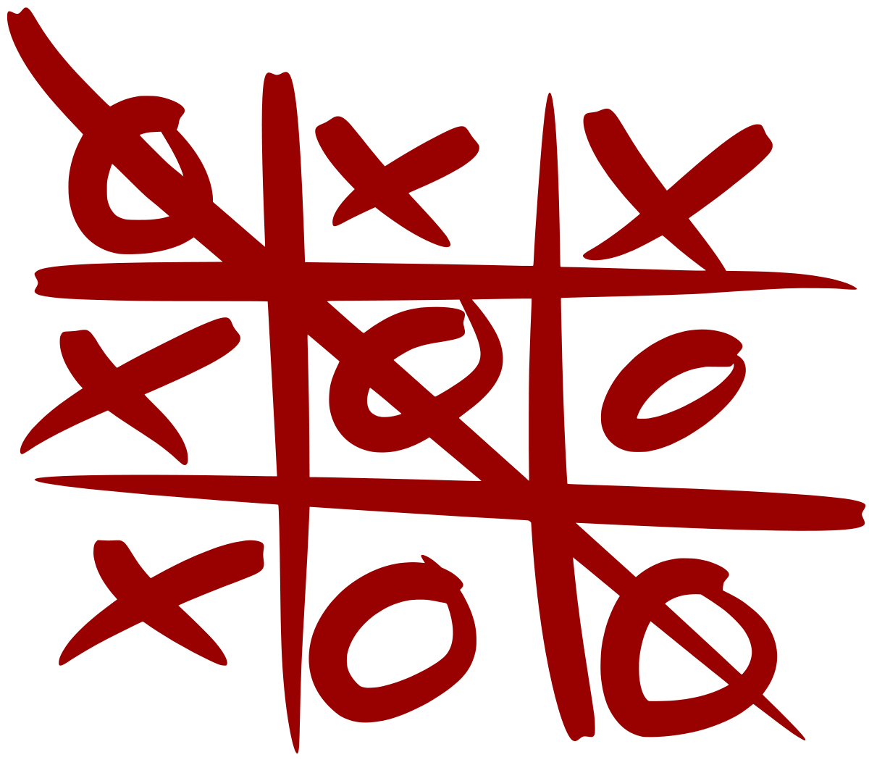
Defining Rules
What are game rules?
Can we define the rules of tic-tac-toe?
Play occurs on a 3x3 grid of 9 empty squares
Two players take turns marking empty squares, first player marking X and second player marking O
If one player places three of the same marks in a row, that player wins
If the spaces are all filled and there is no winner, the game ends in a draw

Slide 4
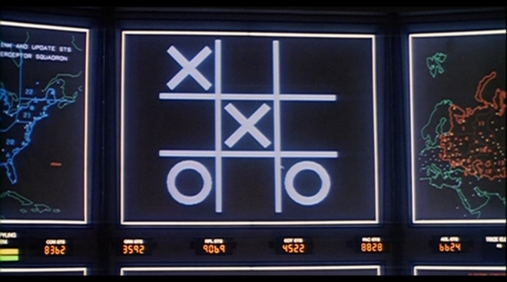
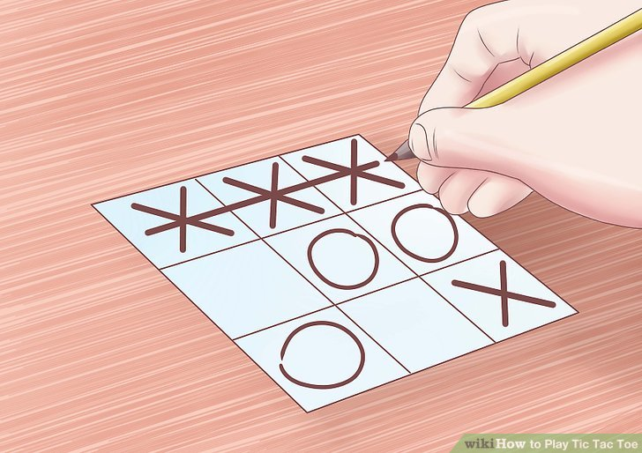
What do rules describe?
Only the formal system of the game in question
Not:
The history
HOW (as in medium) it is played
How enjoyable or not the game is
This ensures that:
Any two players will be playing the same game
Regardless of the medium on which the game is played (paper, PC) it is the same game.

Slide 5

What are rules?
If we’re representing games as formal systems of rules, it’s important that we know what rules are and are not
All games are structured, so how do we decide between a structure in a game that is a rule and one that is not?

Slide 6
Features of a rule
Rules limit player action in some way
There are an infinite number of ways to move a knight from one side of the board to the other in chess, but a much smaller number of ways that are in compliance with the rules
Rules are explicit and unambiguous
Hazy rules “you mostly do it this way…” are not really rules
Rules are shared by all players
If you’re not all playing by the same set of rules, it can’t possibly be a fair game – worth remembering in life as well
Rules are fixed
If rules change regularly, it’s unlikely all will know them, and be following them properly
Rules are binding
If the rules are broken regularly and the game continues, you may be having fun but you’re not really playing the game properly
Rules are repeatable
They remain the same from one game to the next and are portable between different players.

Slide 7
Can you have a game without rules?
Not really, because it arguably ceases to be a game
“Rules are what differentiate games from other kinds of play. Probably the most basic
definition of a game is that it is organized play, that is to say rule-based. If you don't have
rules you have free play, not a game. Why are rules so important to games? Rules impose
limits—they force us to take specific paths to reach goals and ensure that all players take the
same paths. They put us inside the game world by letting us know what is in and out of
Bounds".” — Marc Prensky, Digital Game-Based Learning

Slide 8
Different kinds of rules
Operational rules
The “Rules of Play”. Guidelines players require in order to play, what we’d normally think of as being the “rules” of the game.
Constituative Rules
Underlying formal structures that exist “below the surface” ie. In the case of tic-tac-toe rules such as “if no player can make an addition and there is no winner, the game is a draw”
Implicit Rules
Are the “unwritten rules” of the game, such as “One player will not assault the other to prevent them from making a winning move”, these are usually a potentially infinite list

Slide 9
What about computer games?
Computer games are a little different
In non-digital games, rules are often something that is concretely manifest in an instruction book or in the way the game materials are set up
With a digital game the rules are going to be buried in layers of program code and may be difficult to identify
There will be constraints on what rules are workable in a computer game, that don’t exist in a physical game
For example, a physical game could have a rule which says “each player must reach to place their hand over the deck of cards, first to reach it wins” for obvious reasons this rule wouldn’t really work well in a digital game

Slide 10
In a general sense though
Rules within both physical and digital games are very similar in what they achieve and how they are defined
If you are capable of defining a set of rules for a digital game which are fun to play, you will most likely be able to do the same for a physical game, and vice versa
Intuitively creating a game which is fun is great, and intuition does have a place in design decisions, but being able to add analytical thinking to back that theory up will help you to justify and explain your designs

Slide 11
For example
Encountering a problem in a focus group that players are not encountering and combatting one another, by analysing the rules you establish that they are struggling to recognise a rule which is implicit.
By changing the way the lead up play unfolds, you make the implicit rule as an operational rule which solves the problem of players not moving on a level.
Standing at a spawn point/”camping” is possible. Implicitly suggested that you don’t do that, because other players will hate you.
Make an operational rule so that this is not possible. You are placed somewhere at random when spawning, or the playable area contracts, forcing movement.

Slide 12
An important note
Games are meant to be fun – if a given rule doesn’t make the game more fun, then scrap it
Which leads us to the understanding that limiting the player can make the game more fun
In the previous slides example, reducing the map size is a limitation, it makes the game harder for players to do well at
But it’s a small tweak that has caused battle-royale games to do exceptionally well due to the competitiveness and active gameplay it encourages

Slide 13
Task #1 – 5 minutes
Separate into teams of maximum 4 people
Go and play Frogger! At this link: https://www.froggergames.net/games/html5frogger.html
Then as a team try to identify the rules inherent in frogger, identifying whether they are operational, constituative, or implicit (not too many implicit rules, could go on forever!)
Post these onto Padlet at this link: https://padlet.com/willsayers2k3/5tl61p0u8fdt

Slide 14
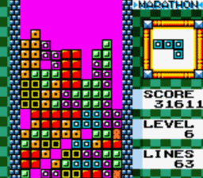
Analysis: Tetris
Let’s do an in-depth analysis of the rules of a digital game
Tetris, is the simple (or is it?) choice for this analysis

Slide 15
Rules of tetris
Play takes place on a grid of 19 by 10 squares
The player can move the currently falling block left and right one grid square by tapping the appropriate keys. If the player holds the appropriate key, aftera pause the block will quick-move in that direction
Blocks cannot be moved off the left or right borders of the grid
The up-direction button does nothing
The player can rotate the currently falling block around it’s centre axis by pressing a particular button
When a portion of the falling block hits the bottom of the grid or another block, the descending block ceases falling
If, when a block stops falling one or more rows of the grid are full completely, these rows empty and all other rows move downwards to fill the gap
As soon as the descending block ceases falling, a new block is created from a random assortment of block shapes
If blocks accumulate so much that the screen is filled, the game is over
The player receives points for each row that disappears, according to a scheme in which removing more rows at once gives more points. Exact points depend on the currently selected difficulty level.
The player can also gain score by accelerating blocks downward, when this is done one point per grid square accelerated through is gained.

Slide 16
Is game code rules?
As games are programmed, the question arises, is the programming code the rules of the game?
Not really
The code will encompass all of the rules that can be represented by the computer,
it’s entirely possible there will be other rules which are either only for the players and not enforced by the computer itself
And it’s a certainty that the code will have functionality for things like running a menu, displaying flashy graphics, etc, which are not part of the rules of the game in the sense in which we are discussing them.

Slide 17
Summary
Generally speaking, digital game rules are similar to those of non-digital games
Internal functioning of game logic is also part of the rules of a digital game (such as how to select a new block in tetris)
Visual and audio aspects of digital games are normally not part of the rules, although they can be
Constituative and Implicit rules of digital and non-digital games are very similar or the same in many circumstances
Operational rules can be very similar but can also have important distinctions – operational rules for digital games may need to specify different things to non-digital

Slide 18
A short task
We are due a library session today
In the time we have left before that, please have a go at the practical activity sheet on moodle
You’ll need to select two games, from the list available for the assignment and follow the sheet to try and think about doing some analysis of the rules of those games.
Once the library session is finished we are going to finish with a second board-game based practical session

